Slide 1

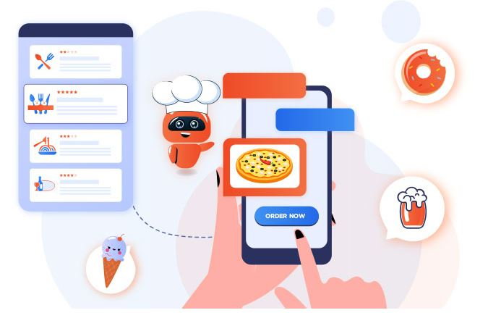

Our Restaurant Chatbot !
By Rami Zaboura and Amir Ashiri

Slide 2


Agenda
ROOF:
Dazzling Mediterranean Roman style roof tiles
Our Goal
Architecture & Lifecycle
Implementing Intents & Entities
Evaluation Metrics
Dialog Management
Conclusions

Slide 3





Why restaurant BOT ??
ROOF:
Dazzling Mediterranean Roman style roof tiles
Cool App !
Cool domain !
Learn NLP, deep learning
What are we building?
Q&A, task-oriented BOT: NLP based
Key challenge = understand user questions/input
Involves sub-tasks
Using Yelp data, Cleveland restaurants

Slide 4


Our Goal
ROOF:
Dazzling Mediterranean Roman style roof tiles
Looking for a good Italian nearby,
to have some whiskey with my dogs…
Yes, please make that reservation!
A table for five for tonight, around 8pm
found 56 Italian bars !
BTW I don’t have info about pets,
so not sure about dogs…
Would you like to make a reservation for this place?
If so, for what time, and how many people will you be?

Slide 5
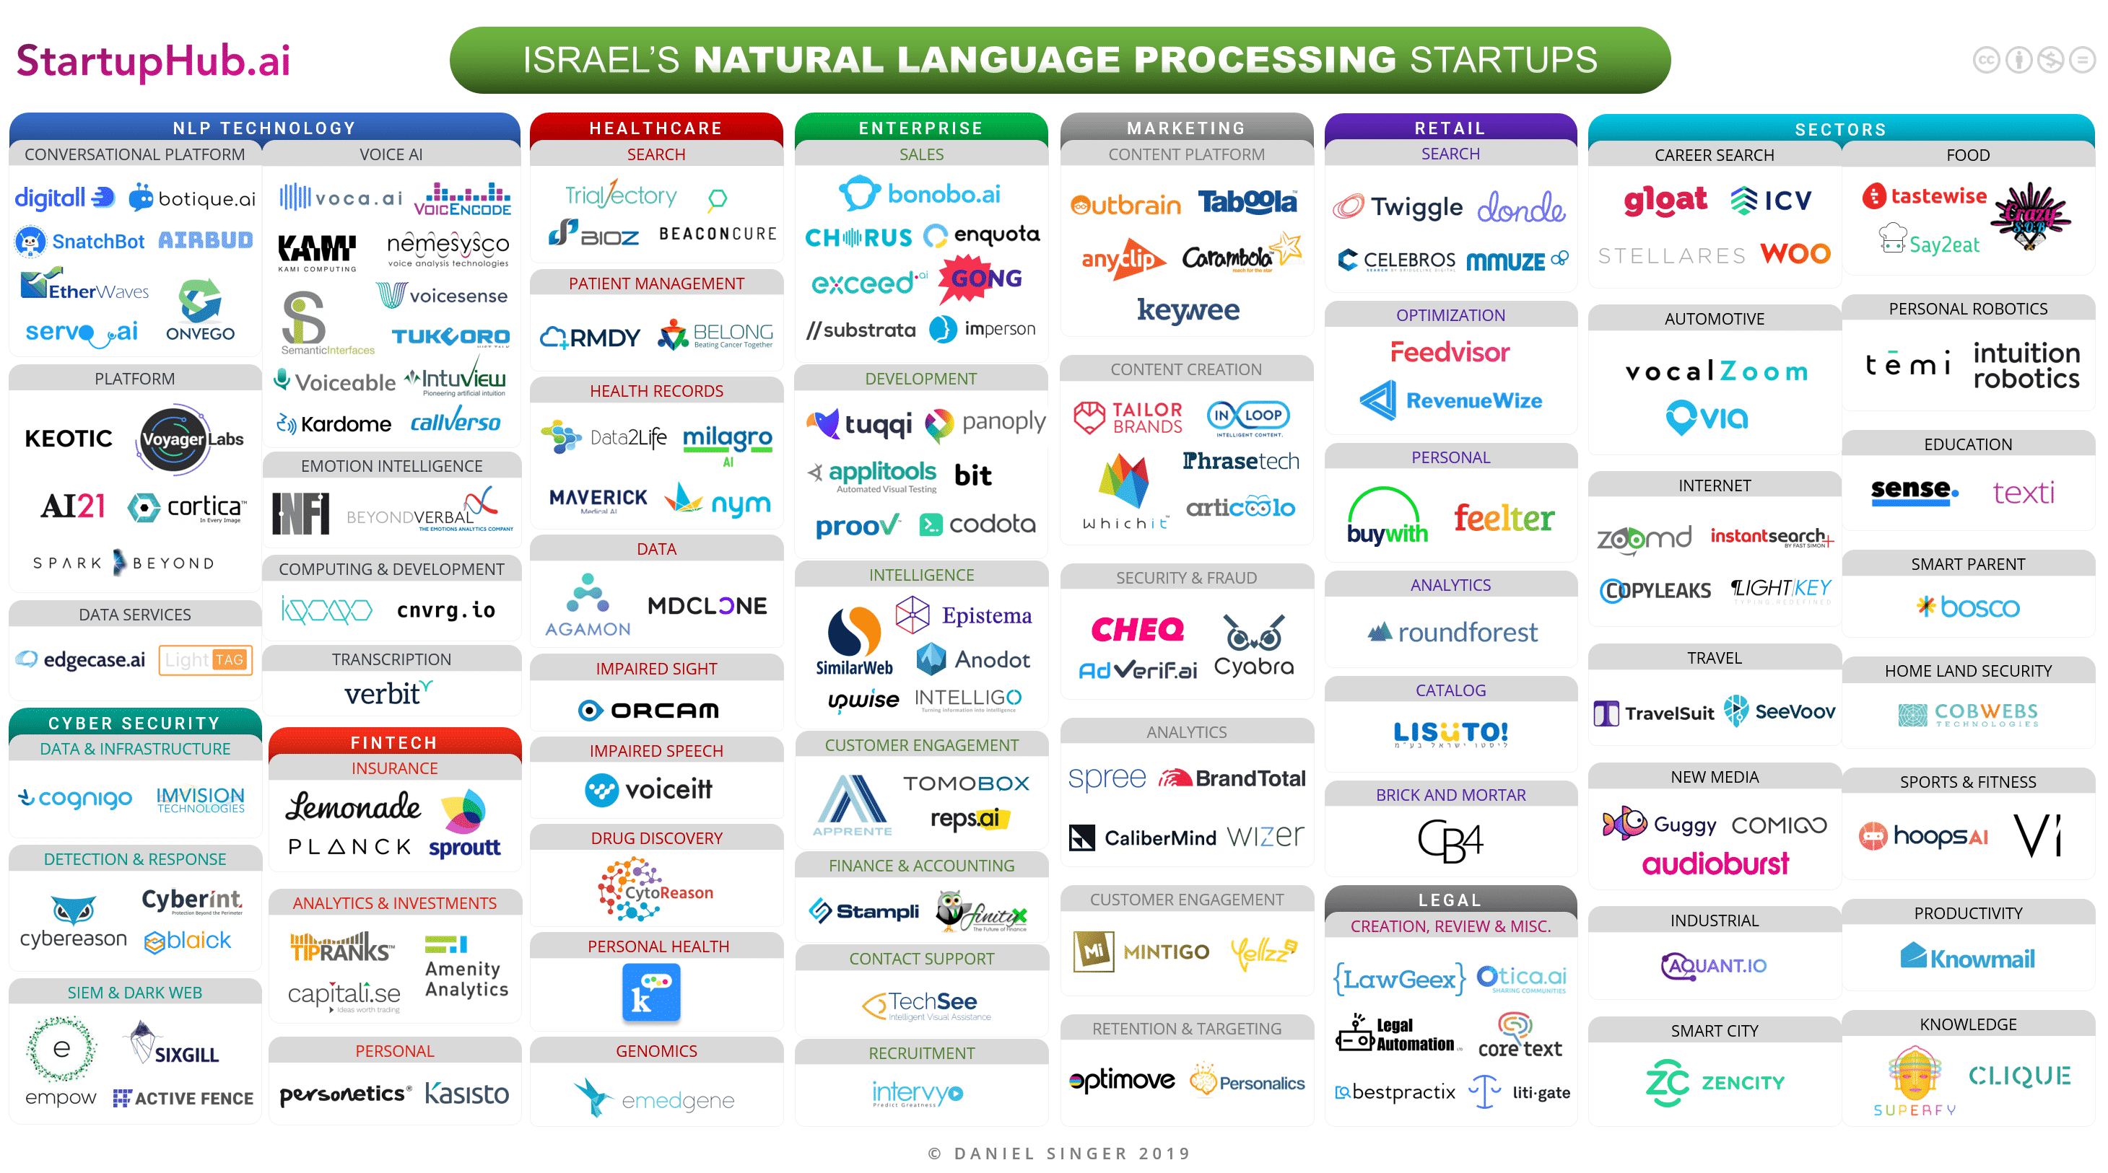
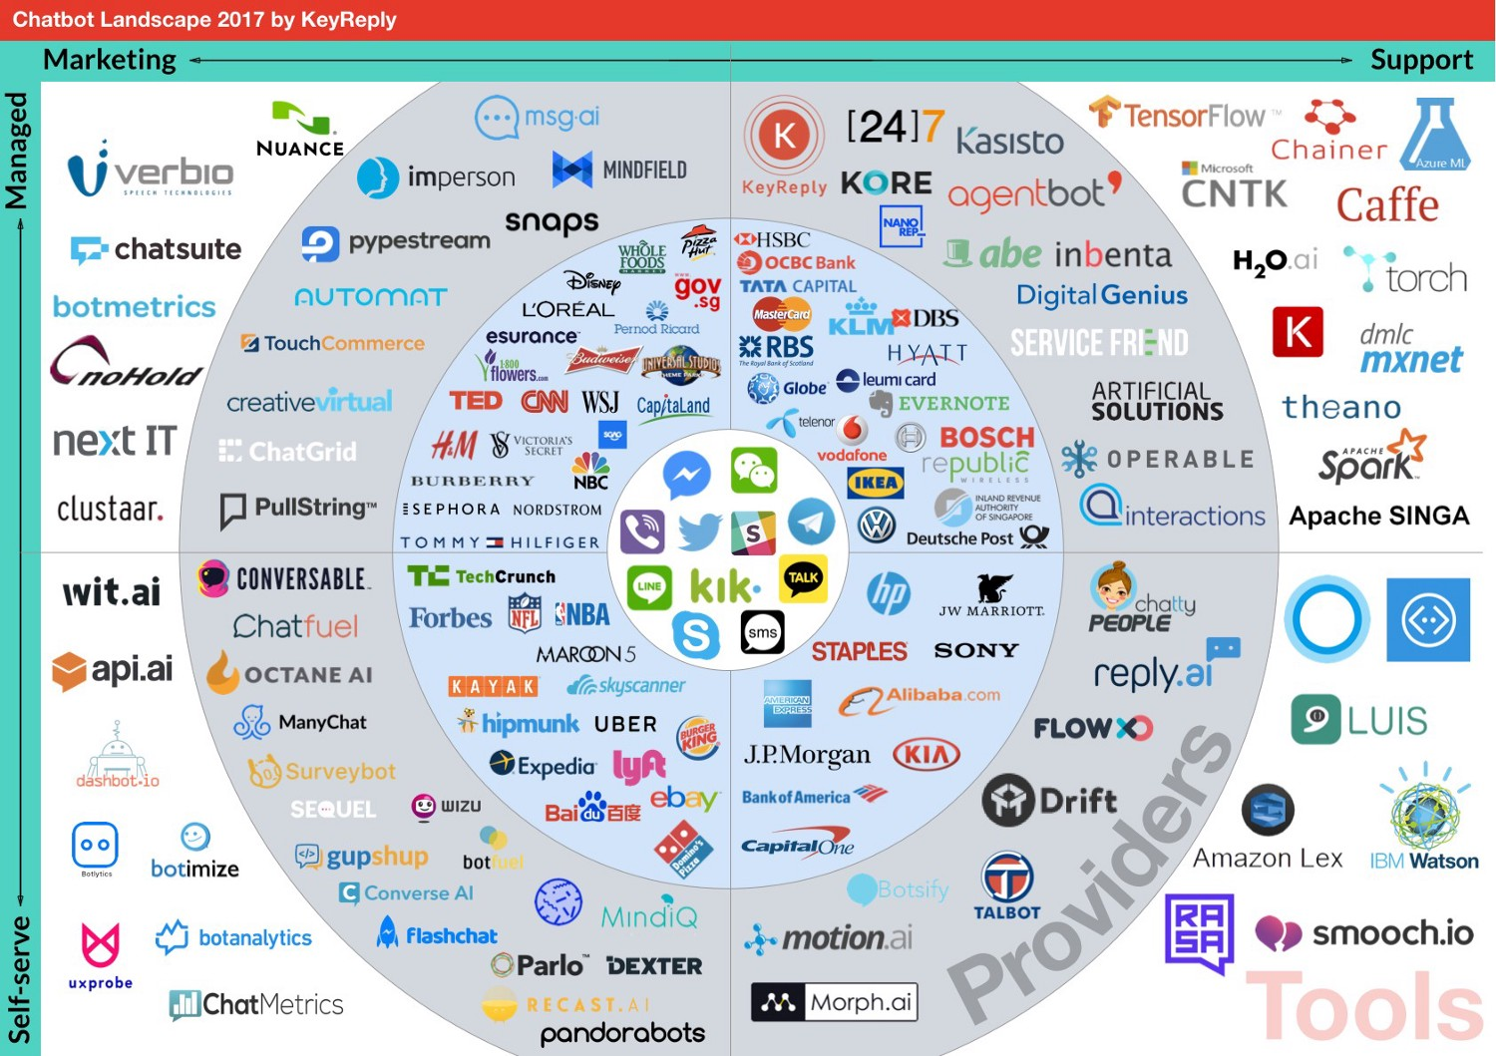
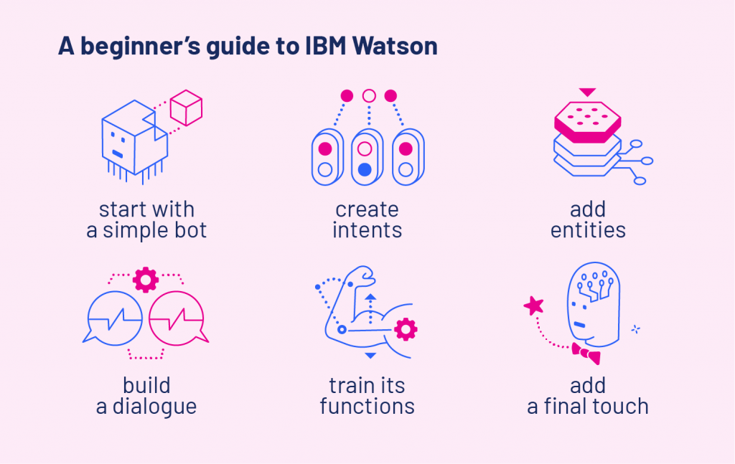
Getting Started: Landscape
ROOF:
Dazzling Mediterranean Roman style roof tiles

Slide 6
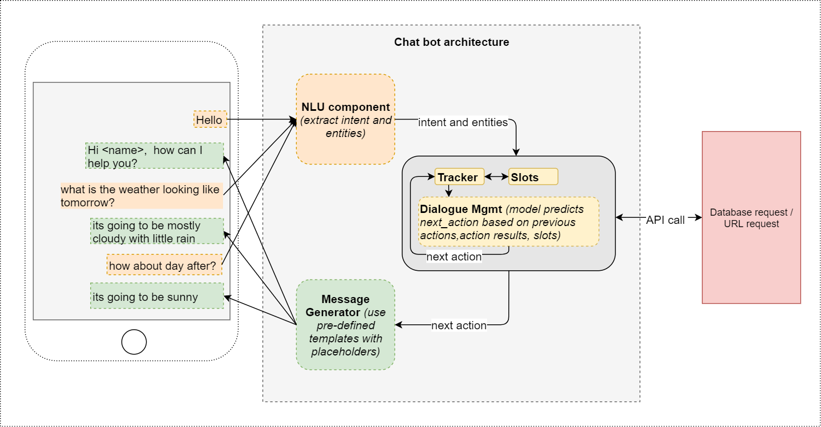

Architecture
ROOF:
Dazzling Mediterranean Roman style roof tiles

Slide 7
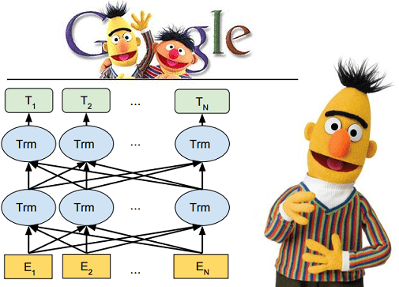
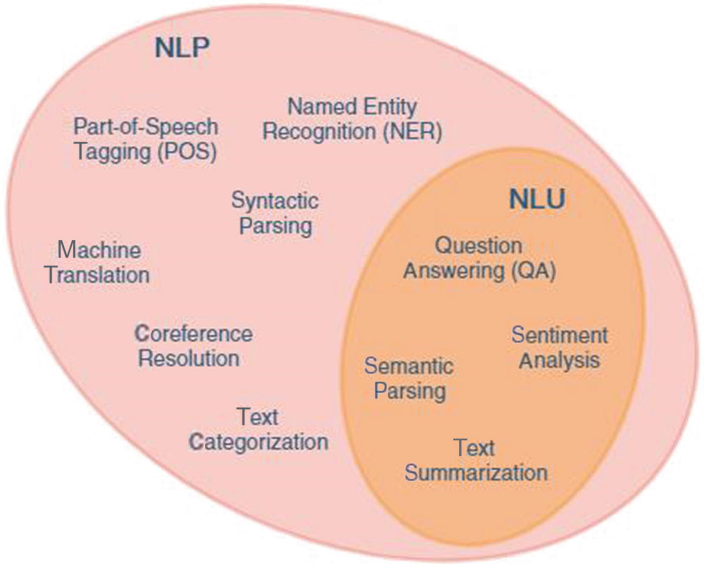
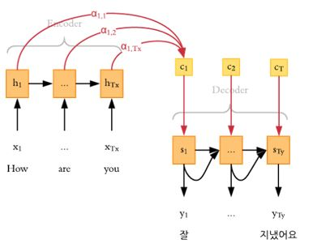
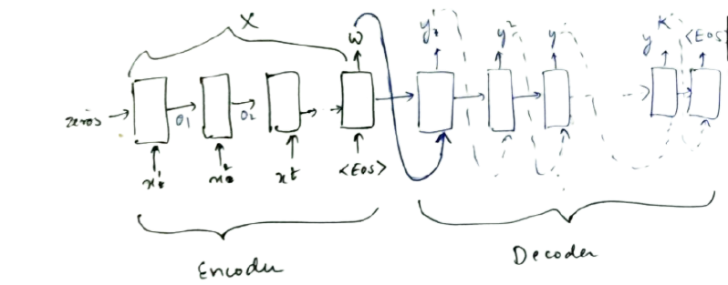
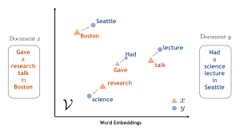

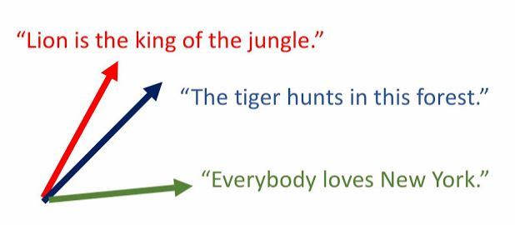

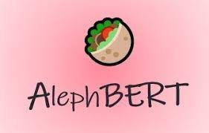



NLU selection: BERT
Word Embedding
Attention
RNN and LSTM -> seq2seq
Attention –> Transformers
BERT (Google, 2018) 2.5B Wikipedia tokens, 375M parameters
GPT-3 (OpenAI, 2020) >> BERT, requires less data, no fine-tuning
Word embedding –> sentence embedding
Our focus is NLU and DM (but not NLG)
Self Attention
Sentence Embedding
Multi-Lingual
Semantic-Aware
Large
RoBERTa
ALBERT

Slide 8
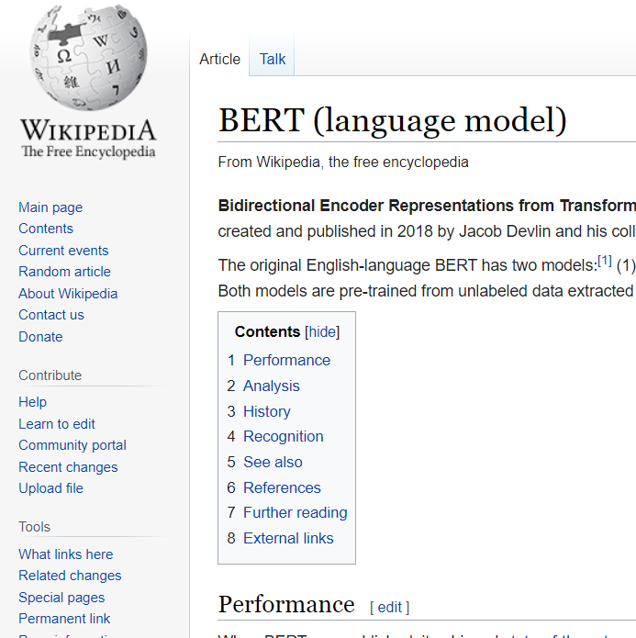
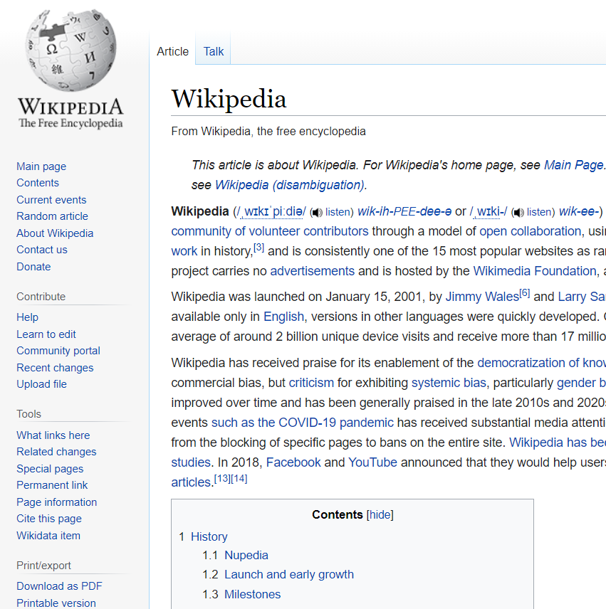


10 Second Philosophy
ROOF:
Dazzling Mediterranean Roman style roof tiles
Does Wikipedia document itself ?
Is BERT aware of itself
?
Sure !

Slide 9
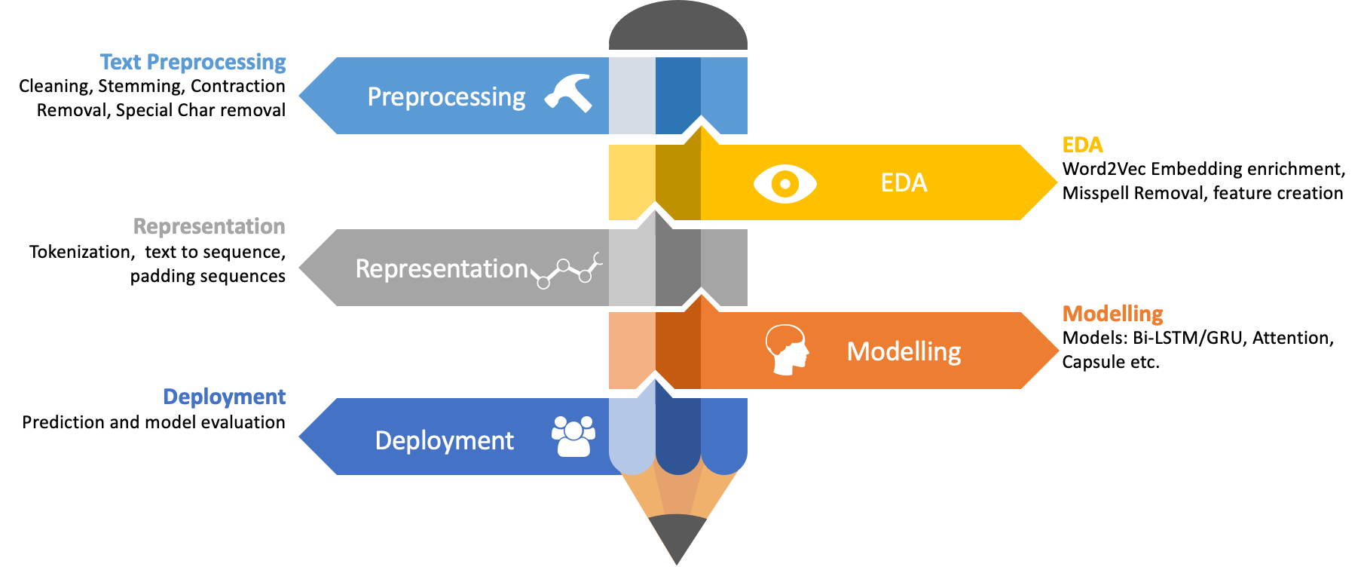

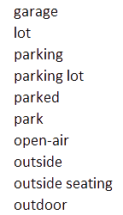

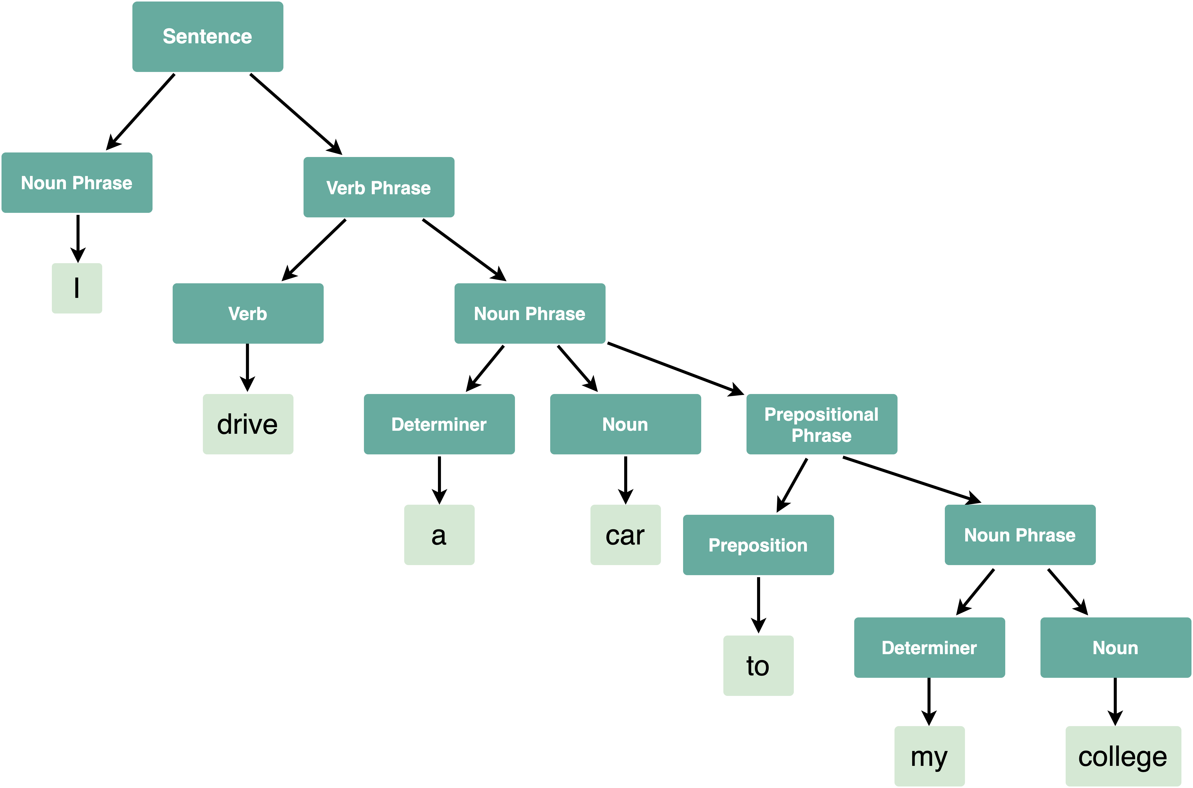

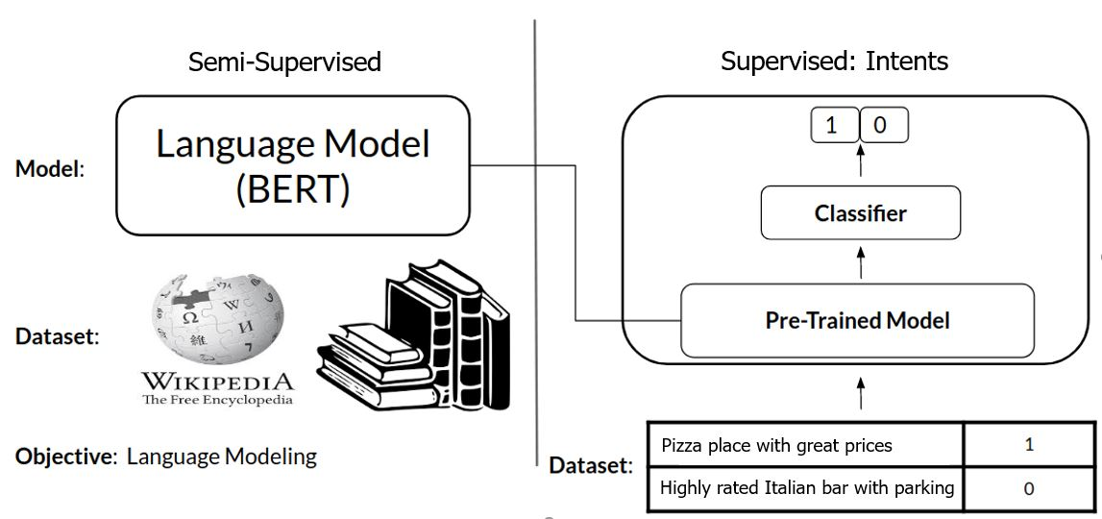
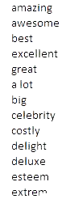
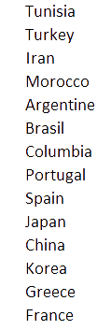


Lifecycle
ROOF:
Dazzling Mediterranean Roman style roof tiles
NLTK
enchant
Self-entered intents
Stop-words, cleansing, non-English
Lemmatizer (carefully)
Part Of Speech
Named Entity Recognition
Special words (RegEx)
don’t = do not
tomorrow = now() + 1 day
Five = 5
Transformers library (HuggingFace)
BERT sentence embedding
XGBoost classifier
Knowledge Transfer
wordnet
Spacy
StanfordNLP

Slide 10
















































Our Intents
View
Business
Ranking
Distance
Price
Kitchen
Service
Time
Food
Kids
Day
People
Promotions
WiFi
Parking
Pets
Payment
Veggy
Outdoor
Music
Dietary
Romantic
Smoking
Access

Slide 11
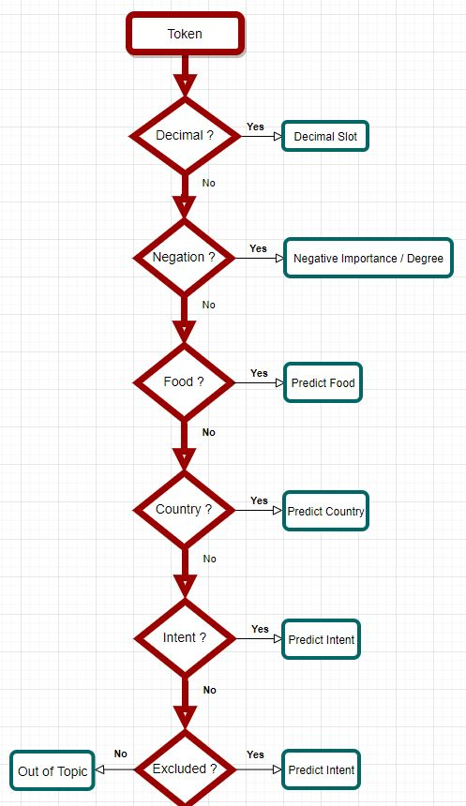






Classification
Intents & Entities: great, cheap, Latin, not, 10:30 …
Multi level models
OneVsRest -> MultiClass
Random words
Looking for a good Italian nearby,
to have some whiskey with my dogs…

Slide 12
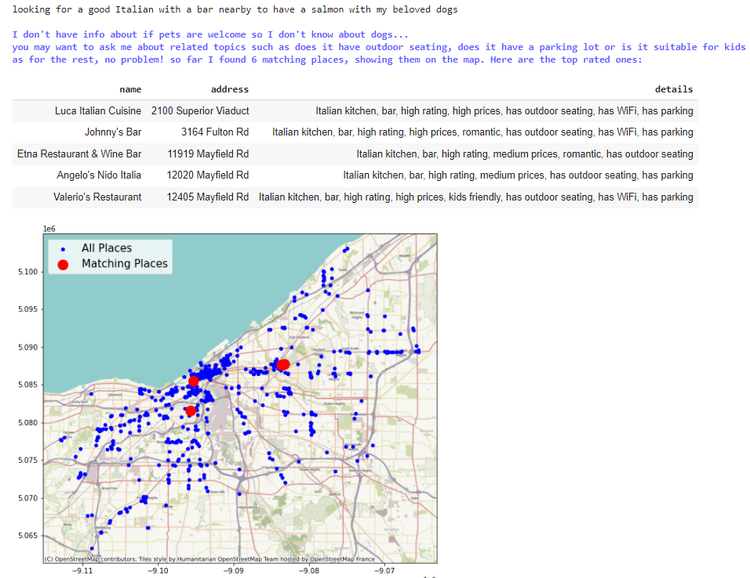

Multi-Intent Parsing
ROOF:
Dazzling Mediterranean Roman style roof tiles

Slide 13
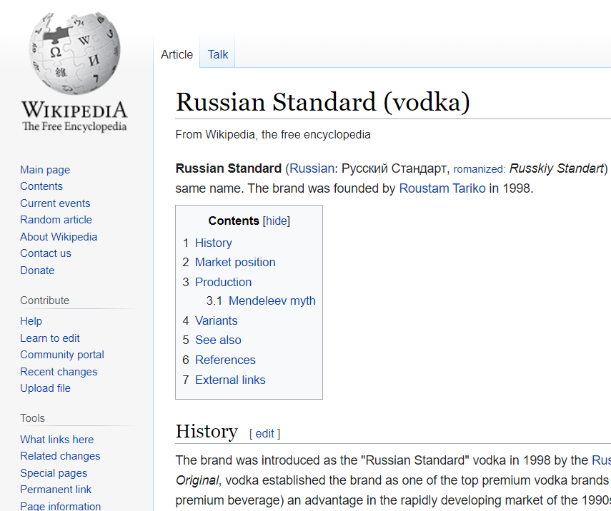
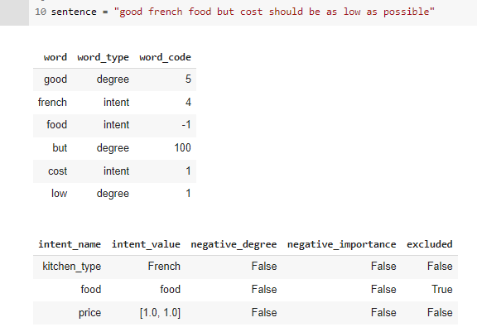
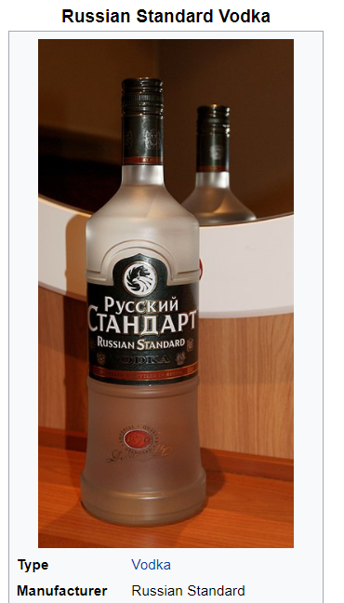

From Utterances to Slots

Slide 14

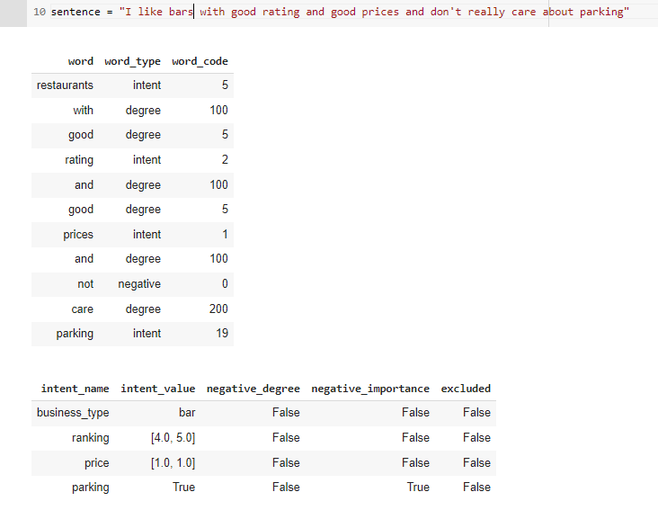
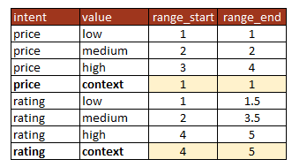
Goodness of good…
ROOF:
Dazzling Mediterranean Roman style roof tiles

Slide 15


Importance

Slide 16
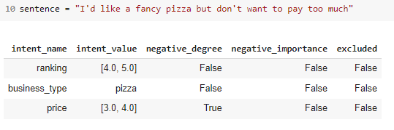

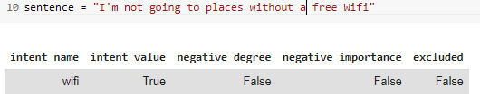
Negative statements

Slide 17
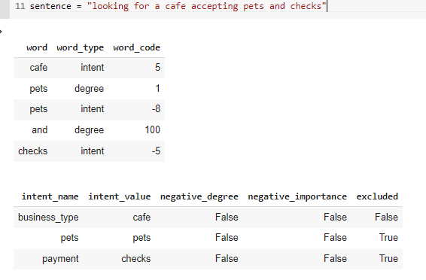
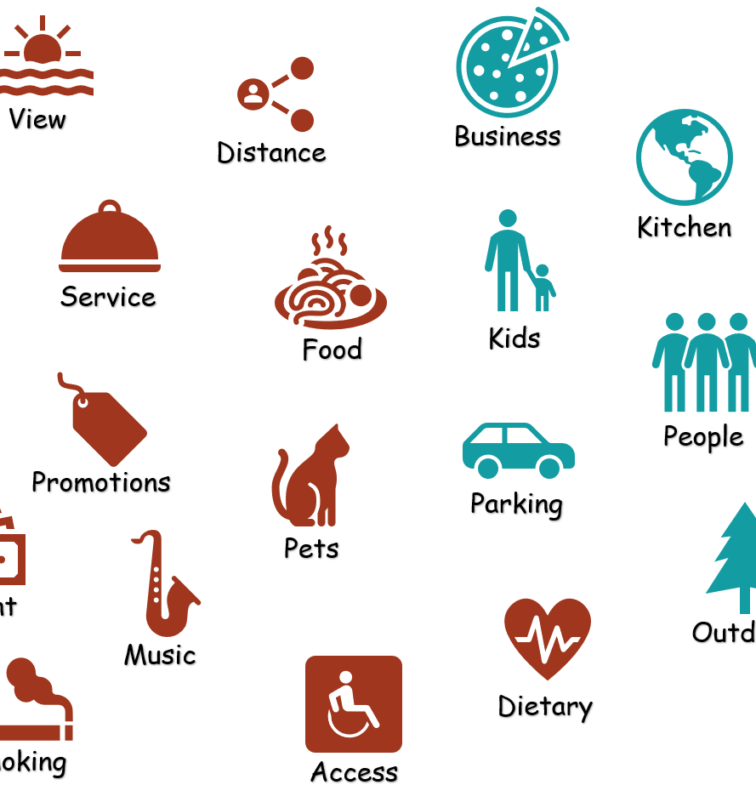

Excluded Intents
ROOF:
Dazzling Mediterranean Roman style roof tiles

Slide 18




Metrics & KPIs
ROOF:
Dazzling Mediterranean Roman style roof tiles
Intrinsic
Intent-based: classification & regression
In NLG:
n-grams overlap: BLEU (precision) and ROUGE (recall)
Perplexity (confusion), Meteor (synonyms), etc.
Extrinsic
Goal completion rate: sales, self service rate, etc.
Satisfaction increase
Active users, daily sessions
Confusion & fallback rate

Slide 19
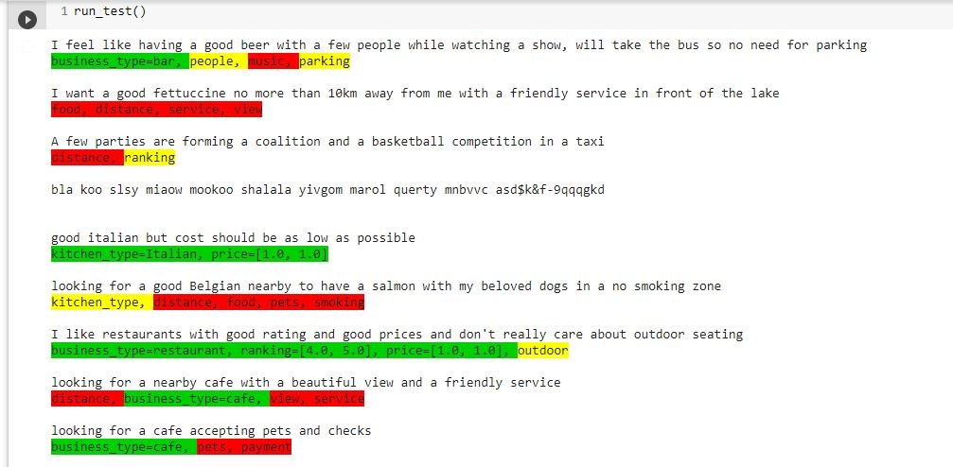



Measurements
Regression Testing
“looking for a place not too far here in the city to enjoy music and good food, steaks is my preference, and if possible outside seating”
“extreme evaluation with basic cost while watching nice landscape and a convenient place to park my car”
“want to have a decent Philly cheesesteak sandwich, calories are not an issue, bringing my cat, and looking for a bargain price”
"I prefer restaurant that don't serve meat since I'm a vegetarian, looking for a friendly place suitable for romance and Haifa style food”
“need a table for five for tonight in a Czech bar, kids friendly, veggie and not, and not pay too much”
Excluded or negative
Partial or don’t care
Fully implemented
Excluded or negative
Partial or don’t care
Fully implemented

Slide 20


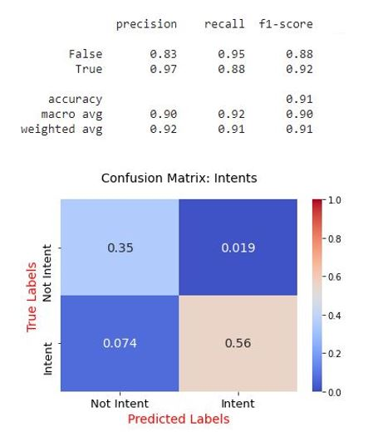
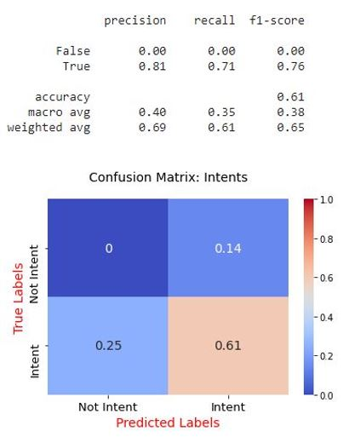
Measurements
cv
cv
cv

Slide 21
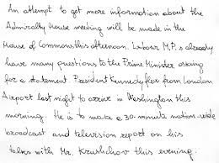


Dialogue Management

Slide 22

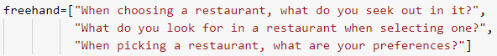
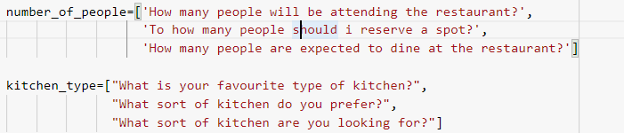
Dialogue Component
Intent Directing:
Define a list of slot-intents to be filled, keep asking the user questions until covering up all different intents or until filtering out appropriate restaurants:
Direct the user by two methods:
first: not-guided method, where we give the user a total of 3 times to enter his preferences regarding restaurants freely:
Second: guided method, Q and A session, where we ask specific guided questions

Slide 23

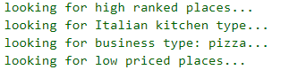
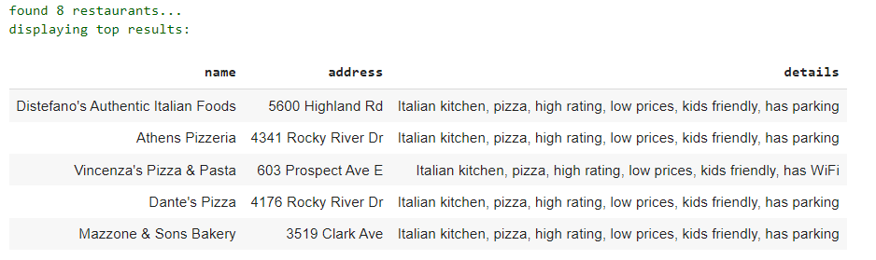
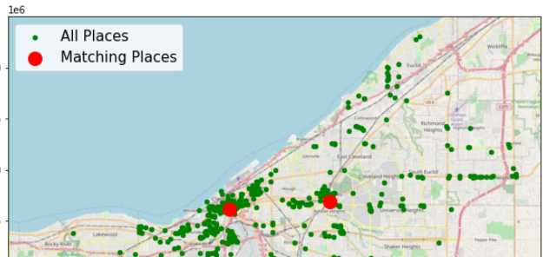
Dialogue Component
ROOF:
Dazzling Mediterranean Roman style roof tiles
Intent response:
The goal here is to give the user feedback in three possible ways:
Verbal feedback:
User input: “looking for a highly rated Italian pizzeria, with good prices”
Feedback:
Data frame feedback:
Map feedback: (if 5 restaurants or less we found

Slide 24
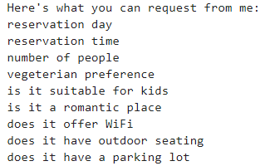
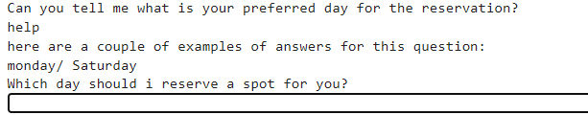
Dialogue Component
ROOF:
Dazzling Mediterranean Roman style roof tiles
Guided vs Unguided:
Different context and application:
Guided -> active intent, where for example the number 5 could be considered legitimate if the active intent is time or number of people
possible requests in case user entered a request with no explicit value:
Unguided:
Guided:
Help meta command/ out of topic1 request:
Unguided : display a list of topics which the user still hasn’t asked about, continuing the last example:
- Guided: specific question- directed request:

Slide 25

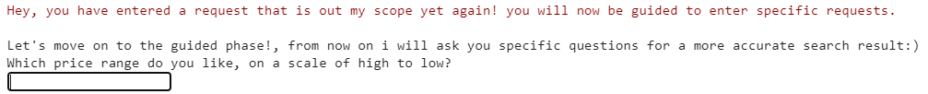
Dialogue Component
ROOF:
Dazzling Mediterranean Roman style roof tiles
Escape Rules:
If the user enters a request that is out of topic/ already answered, deal with it and move him from Unguided phase to guided phase:
- out of topic twice in a row example:

Slide 26
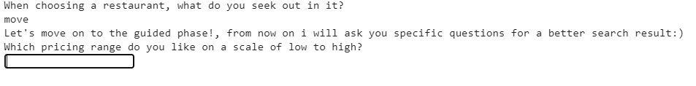
Dialogue Component
ROOF:
Dazzling Mediterranean Roman style roof tiles
Meta commands:
Help – we talked about it previously…
Move – moves the user from the unguided phase to the guided phase in case he wants to be asked specific questions:
Summary- present the user with the list of topics he already requested:
Mike: for situations that the customer is not satisfied,
includes two commands:
Quit : quits chat
Restart: restarts the chat

Slide 27

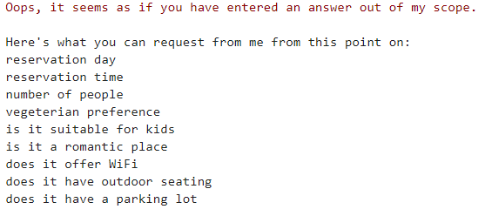
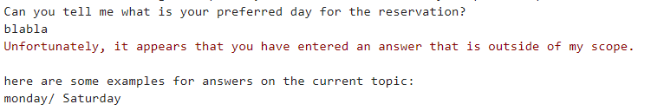
Dialogue Component
ROOF:
Dazzling Mediterranean Roman style roof tiles
Dealing with different issues:
Out of topic1 request: user entered an unrelated request
- User input : “how's the weather today”?
Unguided: Let him know his request is out of scope, and present him with possible not requested yet topics
Guided:

Slide 28
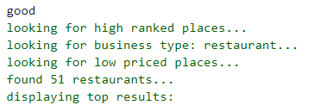
Dialogue Component
ROOF:
Dazzling Mediterranean Roman style roof tiles
Dealing with different issues:
Out of topic2 request: user enters at least one request with no explicit value, deal with that intent/ those intents first, then display feedback for all intents
- User input= “looking for a highly rated restaurant with Wi-Fi and prices”
User input= “good”

Slide 29
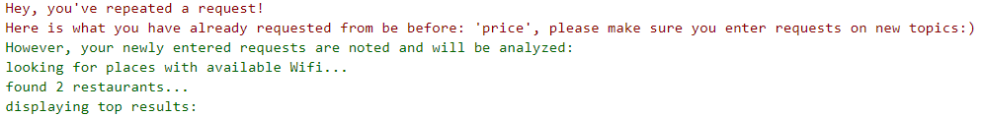
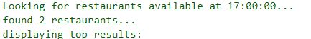
Dialogue Component
ROOF:
Dazzling Mediterranean Roman style roof tiles
Dealing with different issues:
Already answered request: user enters at least one topic he requested before, let him know we already dealt with that topic and deal with other topics
Continuing the user input example presented in the beginning:
- User input= “I want a place with Wi-Fi and good prices”
Unexpected intent (relevant for guided phase only) : User enters a valid request but on a different topic – not answering the question intent
For example:

Slide 30
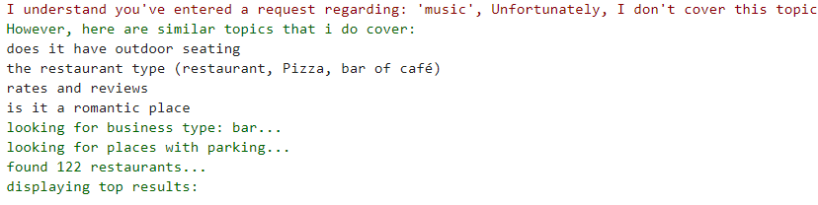
Dialogue Component
ROOF:
Dazzling Mediterranean Roman style roof tiles
Dealing with different issues:
Excluded request: user entered a request relevant to the restaurant world but we don’t cover it. Let the user know that and present him with similar covered topics:
- User input: “find me a bar with parking and good music”

Slide 31



Dialogue Component
ROOF:
Dazzling Mediterranean Roman style roof tiles
Run time example:
Romeo and Juliet ordering a restaurant:
Start with ready preferences:
“On Thursday , Juliet wakes to find her love dead in the tomb and stabs herself with his dagger”
So…
Romantic intent
A couple (people intent)
Day intent
Morning hour (Time intent)
Not suitable for kids (kids intent)

Slide 32


Dialogue Component
ROOF:
Dazzling Mediterranean Roman style roof tiles
Run time example:
Romeo and Juliet ordering a restaurant:
Romeo at this point is stuck and needs guidance…. --> Help

Slide 33

Dialogue Component
ROOF:
Dazzling Mediterranean Roman style roof tiles
Run time example:
Romeo and Juliet ordering a restaurant:
Romeo want to impress Juliet, so:
User input = “find me an expensive, highly rated place”

Slide 34

Dialogue Component
ROOF:
Dazzling Mediterranean Roman style roof tiles
Run time example:
Romeo and Juliet ordering a restaurant:
Romeo is sick of thinking about preferences and wants guidance:
User input = “move”
User input =“Italian” (since Romeo and Juliet were Italian (at-least according to Wikipedia))

Slide 35


Dialogue Component
ROOF:
Dazzling Mediterranean Roman style roof tiles
Run time example:
Romeo and Juliet ordering a restaurant:
At this point, we have reached only one restaurant, there is no point to keep asking the user questions, unless they are order-related (time, day, number of people).
Time -intent was already requested so won’t be asked

Slide 36

Dialogue Component
ROOF:
Dazzling Mediterranean Roman style roof tiles
Run time example:
Romeo and Juliet ordering a restaurant:
User input =“10 am”
User input=“a couple”

Slide 37


Future Improvements
ROOF:
Dazzling Mediterranean Roman style roof tiles
Try GPT-3, chatterbot, RASA
Handle more words (night life, near by)
Try a conversation graph
Add NLP feature engineering & sentiment analysis
Better UI (outside of colab)
Ongoing improvement & user correction

Slide 38

Conclusions
ROOF:
Dazzling Mediterranean Roman style roof tiles
We can accomplish a lot in 3 weeks !
NLP is extremely fun & complex
BERT is very powerful but needs data
Many trade-offs:
Effort
Sophistication
Control

Slide 39










